Slide 1
Web Design and Programming
Week 7
6 June2024
Instructor: Dr. Peeraya Sripian

Slide 2
Course schedule
Week | Date | Topic
1 | 4/18 | Intro to WWW, Intro to HTML
2 | 4/25 | CSS Fundamental
 | 5/2 | Holiday (GW)
3 | 5/9 | CSS and Bootstrap
4 | 5/16 | Work on midterm project
5 | 5/23 | COIL presentation submission of progress of midterm project
6 | 5/30 | Midterm project presentation week
7 | 6/6 | PHP fundamentals + Installation XAMPP
8 | 6/13 | PHP fundamentals 2
9 | 6/20 | mySQL fundamentals
10 | 6/27 | Assessing MySQL using PHP, MVC pattern + Intro of Final project
11 | 7/4 | Cookies, sessions, and authentication + Proposal of final project
12 | 7/11 | Javascript and PHP validation
13 | 7/18 | Final project development
14 | 7/25 | Final project presentation
COIL 22 MAY 18:00-19:30 (counted as 1 class, replacing 23 May)
Notes:
Collaboration presentation
UPM – already talk about connection (MySQL + PHP)
Student can show project (HTML, CSS) and also the connection -> idea for SIT student to do final project (UPM student emphasize on CRUD, technological points – knowledge up to our 10th week)
SIT student – present HTML , CSS, bootstrap, comment on Design of UPM projects
In the future we can add more
Class time at UPM
Group1: Monday 2-4pm, Tuesday 2-5pm (no experience group)
Group2: Thursday 2-5pm, Friday 9-11am
SIT
Thursday 9-12:30 JST (-> 8-11:30)
Think about arrange extra class for COIL (maybe after 6pm or during lunch break in Japan)
Next mtg – FRI 14 Apr 11:30 (Malaysia time)

Slide 3


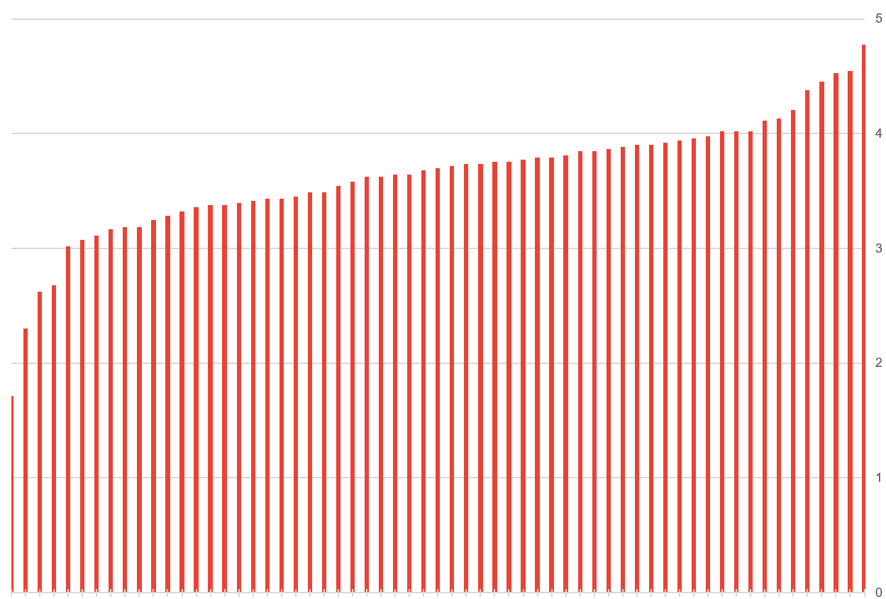

Midterm voting result
Top 3
ID | Score
Z123291 | 4.528302
Z524026 | 4.54717
Z124008 | 4.773585
Congratulations!!

Slide 4
Result on COIL implementation

Slide 5


Today’s topic
Introduction to server side scripting
PHP
Break for 10 minutes
HTML Forms
Submitting Form
In class activity 6 – PHP Fundamentals

Slide 6


Two types of webpages
Static
Dynamic
https://www.shibaura-it.ac.jp/en/
https://www.amazon.com/

Slide 7




How static web pages are processed
HTTP request
HTTP response (with HTML)
Client
(Web browser)
Web server
HTML file
A static webpage is an HTML document stored on a web server and does not change
Usually with filenames .htm .html
When user request a static webpage, the browser send HTTP request include the filename
Web server retrieve HTML from webpage and send it back to browser as part of HTTP response
Browser then renders the HTML into a webpage and display

Slide 8


How dynamic web pages are processed
HTTP request
HTTP response (with HTML)
Client
(Web browser)
Web server
Application Server
Database Server
A dynamic webpage is a webpage that is generated by a server-side program or script.
A web server would looks up the extension of the requested file to find out which application server should process the request
Application server runs the specified script. Often uses the data get from web browser to get the appropriate data from a database server.
When application server finishes processing the data, it generates the HTML for a web page and returns to web server, then return to web browser as part of HTTP response.

Slide 9
Server-side scripting languages
To develop dynamic web pages, we need a server-side scripting language.
Scripting languages run on specific web servers such as IIS and Apache.
Language | Description | Used by
Node.js | Quickest growing. JavaScript code on server-side. No need to learn a new language for back-end development. Good for real time application | Paypal, Uber, LinkedIn, Netflix
PHP | The most used (almost 80% of websites now). Good for content-based web pages. Embed in HTML code. Easy to write. | Facebook*, Wikipedia, Zoom
Java | Good for enterprise, performance. | Google, Amazon, eBay
Ruby | Developing applications fast. Adopted by a lot of startups. | Twitter (early days), Github, Airbnb
Python | Clear and easy to read syntax. Popular for statistical analysis. | Youtube, Instagram, Dropbox, Quora
https://twm.me/best-programming-languages-and-frameworks-for-server-side-web-development/

Slide 10
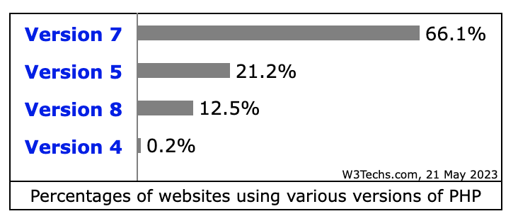
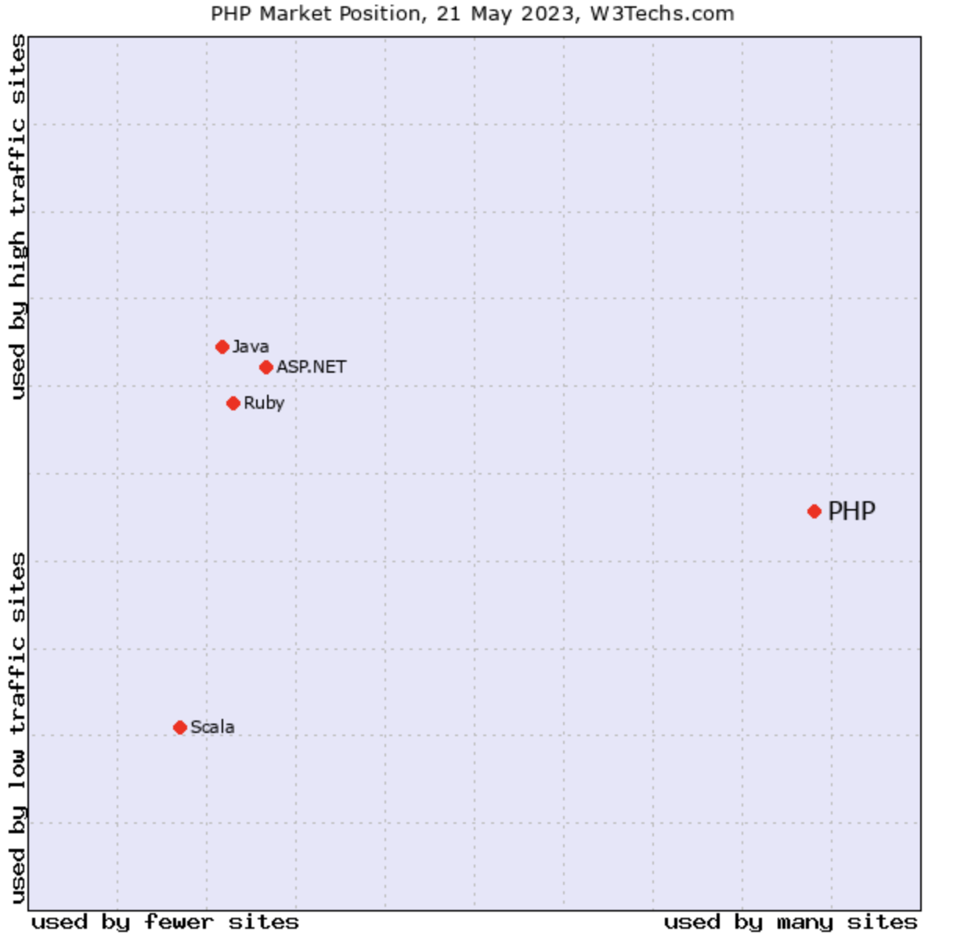
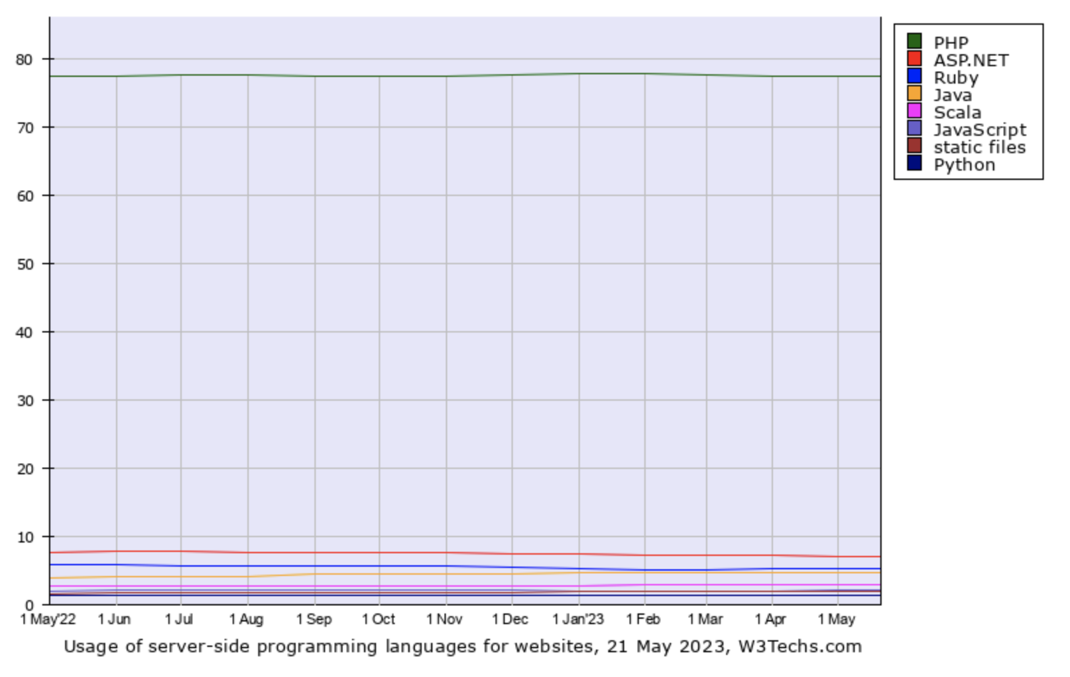
Server-side scripting languages usage
Yes! PHP is not dead yet
Although it is not the best or the most modern language
PHP is used by 77.5% of all the websites whose server-side programming language we know
https://w3techs.com/technologies/details/pl-php/all/all

Slide 11
Bringing it all together
PHP, MySQL, JavaScript (sometimes aided by jQuery or etc.), CSS, and HTML all work together to produce “dynamic web content”
PHP handles all main work on web server
MySQL manages all the data
CSS + JavaScript looks after web page presentation
JavaScript → Talk to PHP code whenever it need to update something
Asynchronous communication in Gmail
Notes:
The real beauty of PHP, MySQL, JavaScript (sometimes aided by jQuery or other
frameworks), CSS, and HTML5 is the wonderful way in which they all work together
to produce dynamic web content: PHP handles all the main work on the web server,
MySQL manages all the data, and the combination of CSS and JavaScript looks after
web page presentation. JavaScript can also talk with your PHP code on the web server
whenever it needs to update something (either on the server or on the web page).
And with the powerful new features in HTML5, such as the canvas, audio and video,
and geolocation, you can make your web pages highly dynamic, interactive, and
multimedia-packed.
Without using program code, let’s summarize the contents of this chapter by looking
at the process of combining some of these technologies into an everyday asynchronous
communication feature that many websites use: checking whether a desired
username already exists on the site when a user is signing up for a new account. A
good example of this can be seen with Gmail (see Figure 1-3).

Slide 12
Gmail username example
Server outputs HTML to create web form
Server attaches some JavaScript to monitor username input box, check for
Typed text or not
Input deselected or not
When text has been entered and the field deselected, the JavaScript pass username to PHP script, wait for response
Web server looks up username (taken yet?) and replies back to JavaScript
JavaScript place indication text next to the username input box (available or not)
If the username is not available, JavaScript interrupts the submission and reemphasizes (alert box?)
Additional: suggest alternative username
* All of these take place in the background quitedly
Notes:
1. The server outputs the HTML to create the web form, which asks for the necessary
details, such as username, first name, last name, and email address.
2. At the same time, the server attaches some JavaScript to the HTML to monitor
the username input box and check for two things: whether some text has been
typed into it, and whether the input has been deselected because the user has
clicked on another input box.
3. Once the text has been entered and the field deselected, in the background the
JavaScript code passes the username that was entered back to a PHP script on the
web server and awaits a response.
4. The web server looks up the username and replies back to the JavaScript regarding
whether that name has already been taken.
5. The JavaScript then places an indication next to the username input box to show
whether the name is available to the user—perhaps a green checkmark or a red
cross graphic, along with some text.
6. If the username is not available and the user still submits the form, the JavaScript
interrupts the submission and reemphasizes (perhaps with a larger graphic
and/or an alert box) that the user needs to choose another username.
7. Optionally, an improved version of this process could even look at the username
requested by the user and suggest an alternative that is currently available.

Slide 13

Development Server
WAMP, MAMP, LAMP :
W: Windows | M: Mac | L: Linux
A: Apache
M: MySQL
P: PHP
Packages that bind the bundles programs together to a single program
Recommended program: XAMPP
https://www.apachefriends.org/download.html
Note: Use Safari to open the link in Mac (I have a problem when use Chrome or Edge in Mac)

Slide 14
PHP

Slide 15
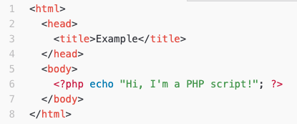
PHP
PHP
recursive acronym for "PHP: Hypertext Preprocessor"
widely-used Open Source general-purpose scripting language
especially suited for Web development
can be embedded into HTML.
PHP scripts reside between reserved PHP tags
This allows the programmer to embed PHP scripts within HTML pages
Save as demo.php
Notes:
d

Slide 16
What is PHP (cont’d)
Interpreted language, scripts are parsed at run-time rather than compiled beforehand
Executed on the server-side
Source-code not visible by client
‘View Source’ in browsers does not display the PHP code
Various built-in functions allow for fast development
Compatible with many popular databases

Slide 17
PHP Overview
Easy learning
Syntax Perl- and C-like syntax. Relatively easy to learn.
Large function library
Embedded directly into HTML
Interpreted, no need to compile
Open Source server-side scripting language designed specifically for the web.

Slide 18
PHP Overview (cont.)
Conceived in 1994
Outputs not only HTML but can output XML, images (JPG & PNG), PDF files and even Flash movies all generated on the fly. Can write these files to the file system.
Supports a wide-range of databases (20+ODBC).
PHP also has support for talking to other services using protocols such as LDAP, IMAP, SNMP, NNTP, POP3, HTTP.
PHP is used by 77.5%* of all the websites whose server-side programming language we know.
*Updated May 2023

Slide 19
What does PHP code look like?
Structurally similar to C/C++
Supports procedural and object-oriented paradigm (to some degree)
All PHP statements end with a semi-colon
Each PHP script must be enclosed in the reserved PHP tag
<?php
… ?>

Slide 20
Comments in PHP
There are 3 ways to write comments in PHP
Standard C, C++, and shell comment symbols
// C++ and Java-style comment (single line comment)
# Shell-style comments (single line comment)
/* C-style comments (block comment)
These can span multiple lines */

Slide 21
Variables in PHP
PHP variables must begin with a “$” sign
Case-sensitive $Foo != $foo != $fOo
Global and locally-scoped variables
Global variables can be used anywhere
Local variables restricted to a function or class
Certain variable names reserved by PHP
Form variables $_POST, $_GET
Server variables $_SERVER
Etc.

Slide 22
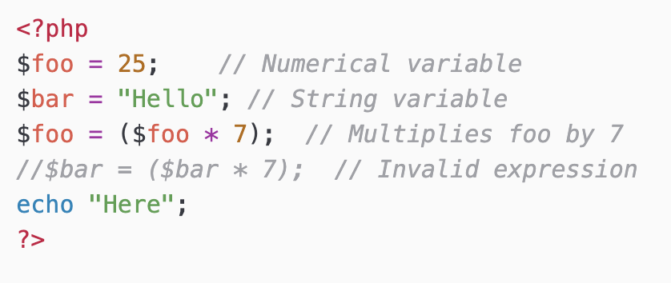
Variable usage

Slide 23
Echo
The PHP command ‘echo’ is used to output the parameters passed to it
The typical usage for this is to send data to the client’s web-browser
Syntax
void echo (string arg1 [, string argn...])
In practice, arguments are not passed in parentheses since echo is a language construct rather than an actual function

Slide 24
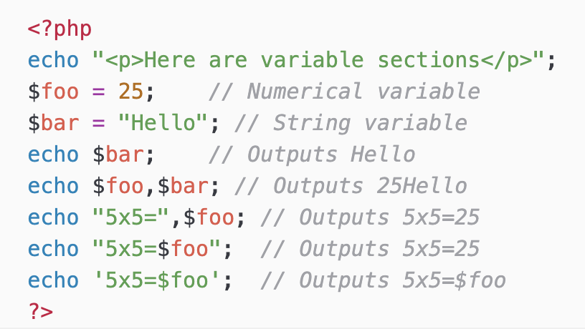
Echo example
Notice how echo ‘5x5=$foo’ outputs $foo rather than replacing it with 25
Strings in single quotes (‘ ’) are not interpreted or evaluated by PHP
This is true for both variables and character escape-sequences (such as \n or \\)
We can also use print, printf instead of echo

Slide 25
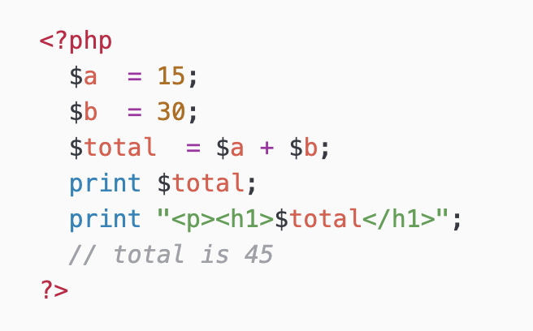
Arithmetic Operations
$a - $b // subtraction
$a * $b // multiplication
$a / $b // division
$a += 5 // $a = $a+5 Also works for *= and /=
echo and print are similar

Slide 26
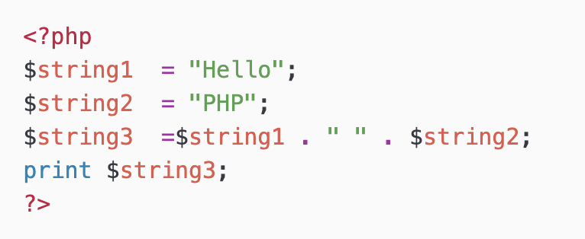
Concatenation
Use a period “.” to join strings into one.
Output
Hello PHP

Slide 27
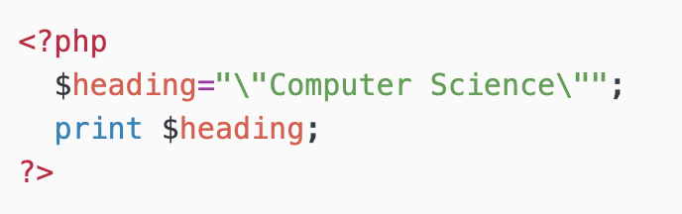
Escaping the Character
If the string has a set of double quotation marks that must remain visible, use the \ [backslash] before the quotation marks to ignore and display them.
Output
“Computer Science”

Slide 28
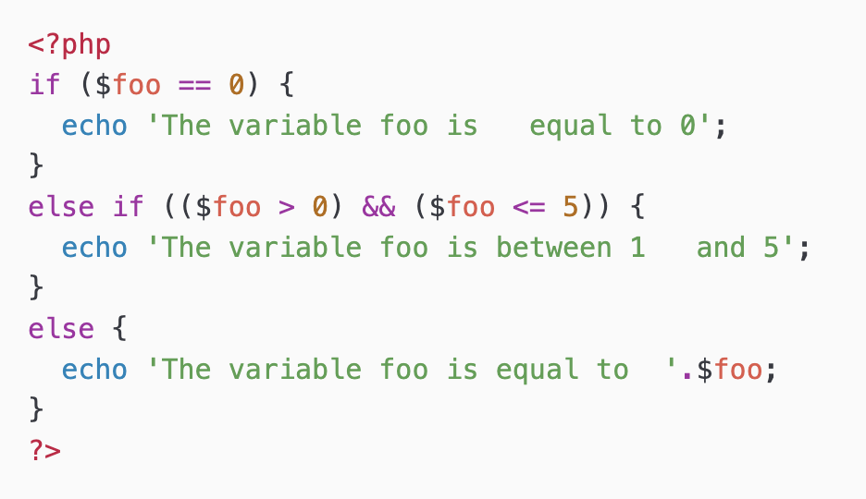
PHP Control Structures
Control Structures
Grouped into conditional (branching) structures (e.g. if/else) and repetition structures (e.g. while loops).
Example of if/else statement →
Notes:
Control structure are the structures within a language that allow us to control the flow of execution through a program or script.

Slide 29
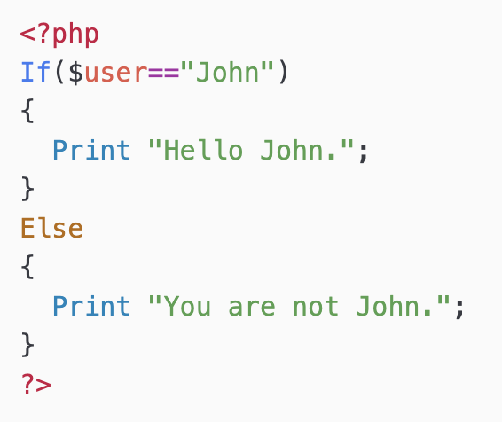
If ... Else...
if (condition)
{
Statements;
}
else
{
Statement;
}
No THEN in PHP

Slide 30
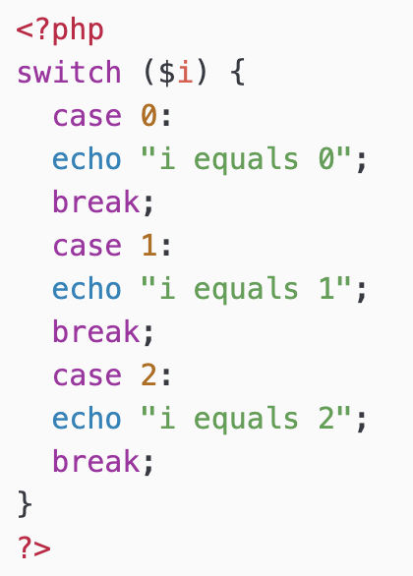
Switch….case….
Can also use with string eg… case(“boy”), case(“girl”)
switch(expr)
{
case (condition):
Statements;
break;
case (condition):
Statements;
break;
default :
Statements;
}

Slide 31
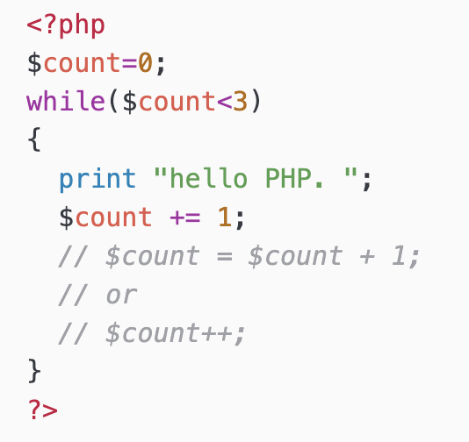
While Loops
while (condition)
{
Statements;
}
Output
hello PHP. hello PHP. hello PHP.

Slide 32
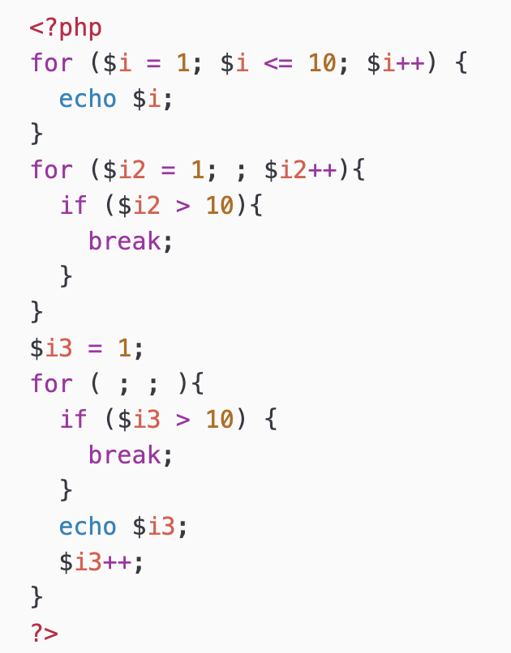
For
for(expr1; expr2; expr3)
{
Statements;
}

Slide 33
Comparing operator
== equal
!= OR <> not equal
< less than
> more than
<= less than or equal to
>= more than or equal to

Slide 34
Logical operator
&& OR and And
|| OR or Or
! Not
^ OR xor Exclusive Or

Slide 35
Functions
A set of statements that performs a particular function and optionally returns a value.
Advantages
Less typing
Reduce syntax and other programming errors
Decrease the loading time of program files
Decrease execution time (function is compiled only once)
Accept arguments and can be used for general or specific cases

Slide 36
PHP Functions
PHP comes with hundreds of ready-made, built in function
Example:
echo date("l"); // Displays the day of the week
phpinfo();
echo strrev(" .dlrow olleH"); // Reverse string // Hello world.
echo str_repeat("Hip ", 2); // Repeat string // Hip Hip
echo strtoupper("hooray!"); // String to uppercase // HOORAY!
echo strtolower(“HOOrAY!"); // String to lowercase // hooray!)
echo ucfirst(“hello”); // First character of a string to uppercase // Hello
Can take any number of arguments, including zero

Slide 37
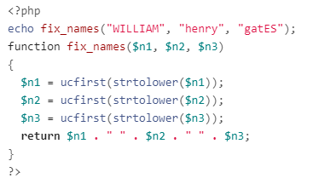
Defining a function
Optional
One or more parameters
Separated by commas
function function_name([parameter [, ...]])
{
Statements;
return statement;
}
A definition starts with “function”
Function name (must start with a letter or underscore _)
Parentheses () are required
Output
William Henry Gates
Users often leave their Caps Lock key on, or accidentally insert capital letters in the wrong places.

Slide 38
PHP Arrays
An array can store one or more values in a single variable name.
Each element in the array is assigned its own ID so that it can be easily accessed.
$array[key] = value;

Slide 39
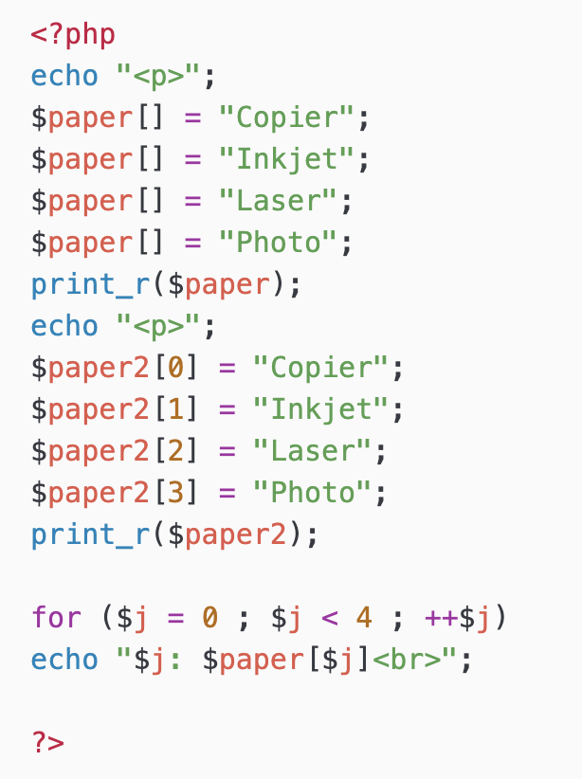
Numerical Indexes
0 | 1 | 2 | 3
$paper
“Copier” | “Inkjet” | “Laser” | “Photo”
0 | 1 | 2 | 3
$paper2
“Copier” | “Inkjet” | “Laser” | “Photo”
Output
Array ( [0] => Copier [1] => Inkjet [2] => Laser [3] => Photo )
Array ( [0] => Copier [1] => Inkjet [2] => Laser [3] => Photo )

Slide 40
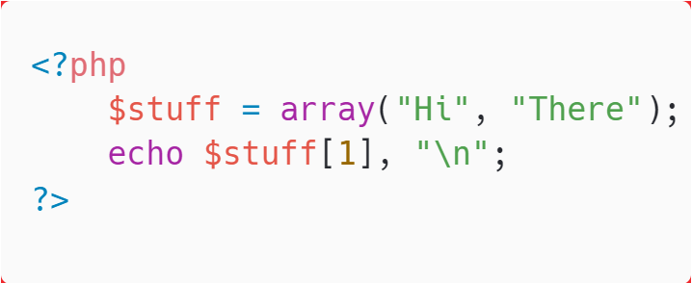
Numerical array
$names = array("Peter","Quagmire","Joe");
Automatically
Manually
$names[0] = "Peter";
$names[1] = "Quagmire";
$names[2] = "Joe";
Output
There

Slide 41
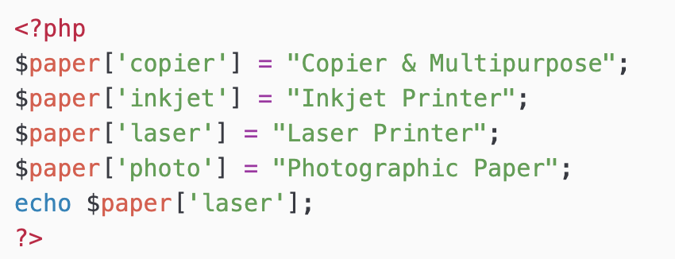
Associative Arrays
Index / key
value
An associative array, each ID key is associated with a value.
When storing data about specific named values, a numerical array is not always the best way to do it.
With associative arrays we can use the values as index or keys and assign values to them.
Not possible in C
Notes:
Associative Arrays
Keeping track of array elements by index works just fine, but can require extra work in terms of remembering which number refers to which product. It can also make
code hard for other programmers to follow.
This is where associative arrays come into their own. Using them, you can reference the items in an array by name rather than by number.
This very powerful feature of PHP is often used when you are extracting information
from XML and HTML. For example, an HTML parser such as those used by a search
engine could place all the elements of a web page into an associative array whose
names reflect the page’s structure:
$html['title'] = "My web page";
$html['body'] = "... body of web page ...";

Slide 42
Associative Arrays
Often used when you are extracting information from XML and HTML.
For example, the HTML parser (used by search engine)
Place all the elements of a web page into an associative array
$html['title'] = "My web page";
$html['body'] = "... body of web page ...";
Break down all the links in a page into another array
Also break all headings and subheadings into another array
Easy to write and debug
Notes:
The program would also probably break down all the links found within a page into
another array, and all the headings and subheadings into another. When you use
associative rather than numeric arrays, the code to refer to all of these items is easy to
write and debug.

Slide 43
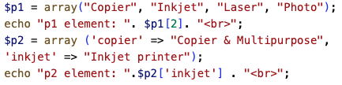
Assignment using array keyword
The old way and shorten style of assignment
Assignment using format
key => value
echo $p1['inkjet']; // Undefined index
echo $p2[3]; // Undefined offset

Slide 44
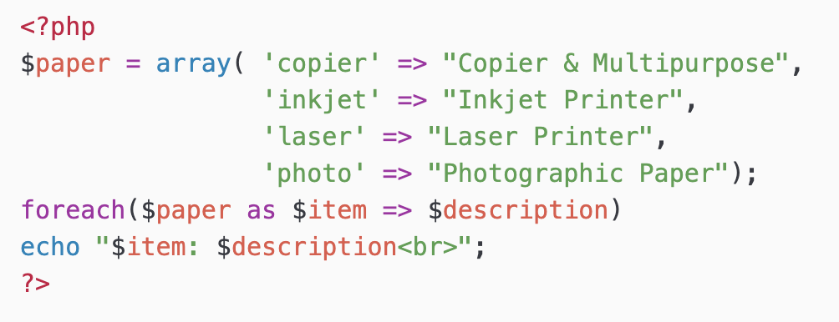
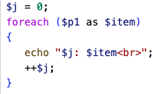
foreach .. As loop
Created in PHP especially for arrays
$p2 = array ('copier' => "Copier & Multipurpose",
'inkjet' => "Inkjet printer");
$p1 = array("Copier", "Inkjet", "Laser", "Photo");
Numerical index
Associative arrays

Slide 45
Multidimensional Arrays
In a multidimensional array, each element in the main array can also be an array.
Each element in the sub-array can be an array, and so on.

Slide 46
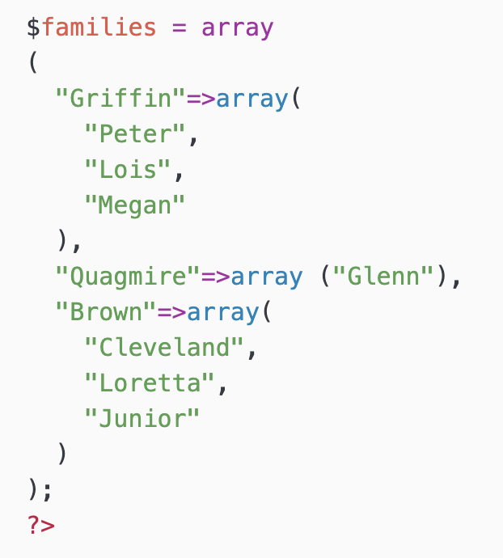
Example
demo
families
Glenn
Cleveland
Loretta
Junior
Griffin
Quagmire
Brown
Peter
Lois
Megan

Slide 47
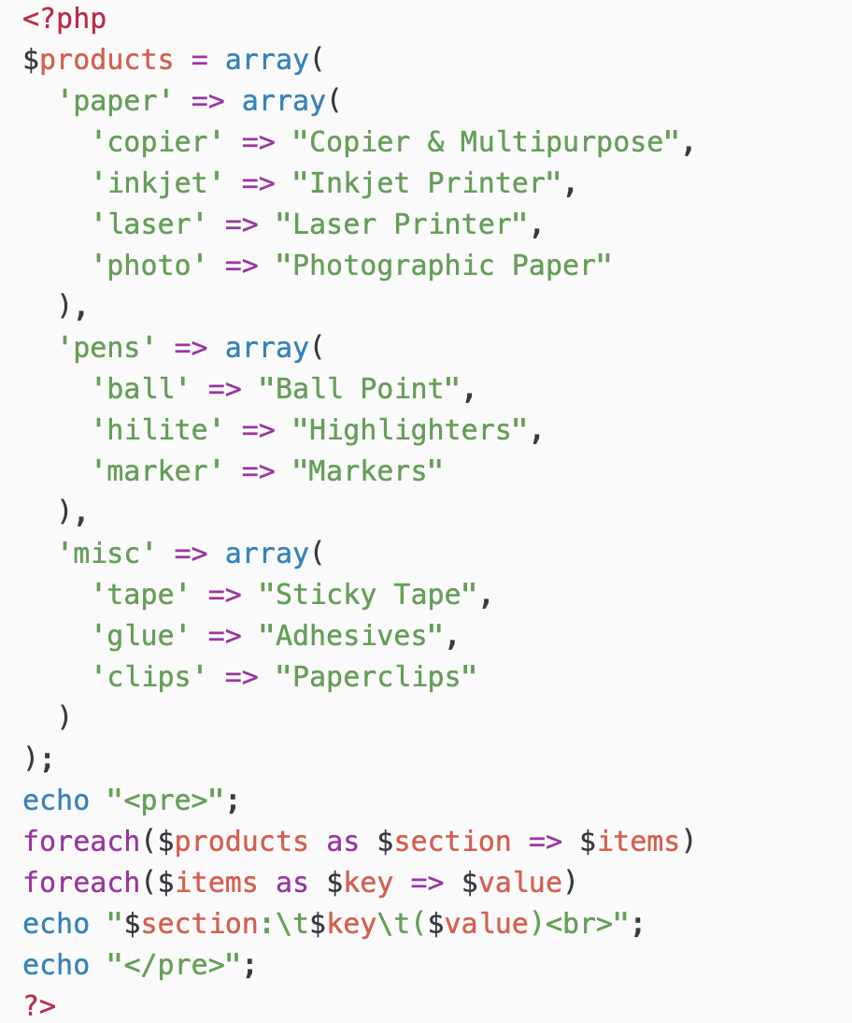
Output
paper: copier (Copier & Multipurpose)
paper: inkjet (Inkjet Printer)
paper: laser (Laser Printer)
paper: photo (Photographic Paper)
pens: ball (Ball Point)
pens: hilite (Highlighters)
pens: marker (Markers)
misc: tape (Sticky Tape)
misc: glue (Adhesives)
misc: clips (Paperclips)
echo $products['misc']['glue'];
Output
Adhesives

Slide 48
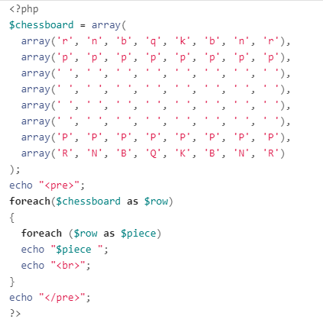
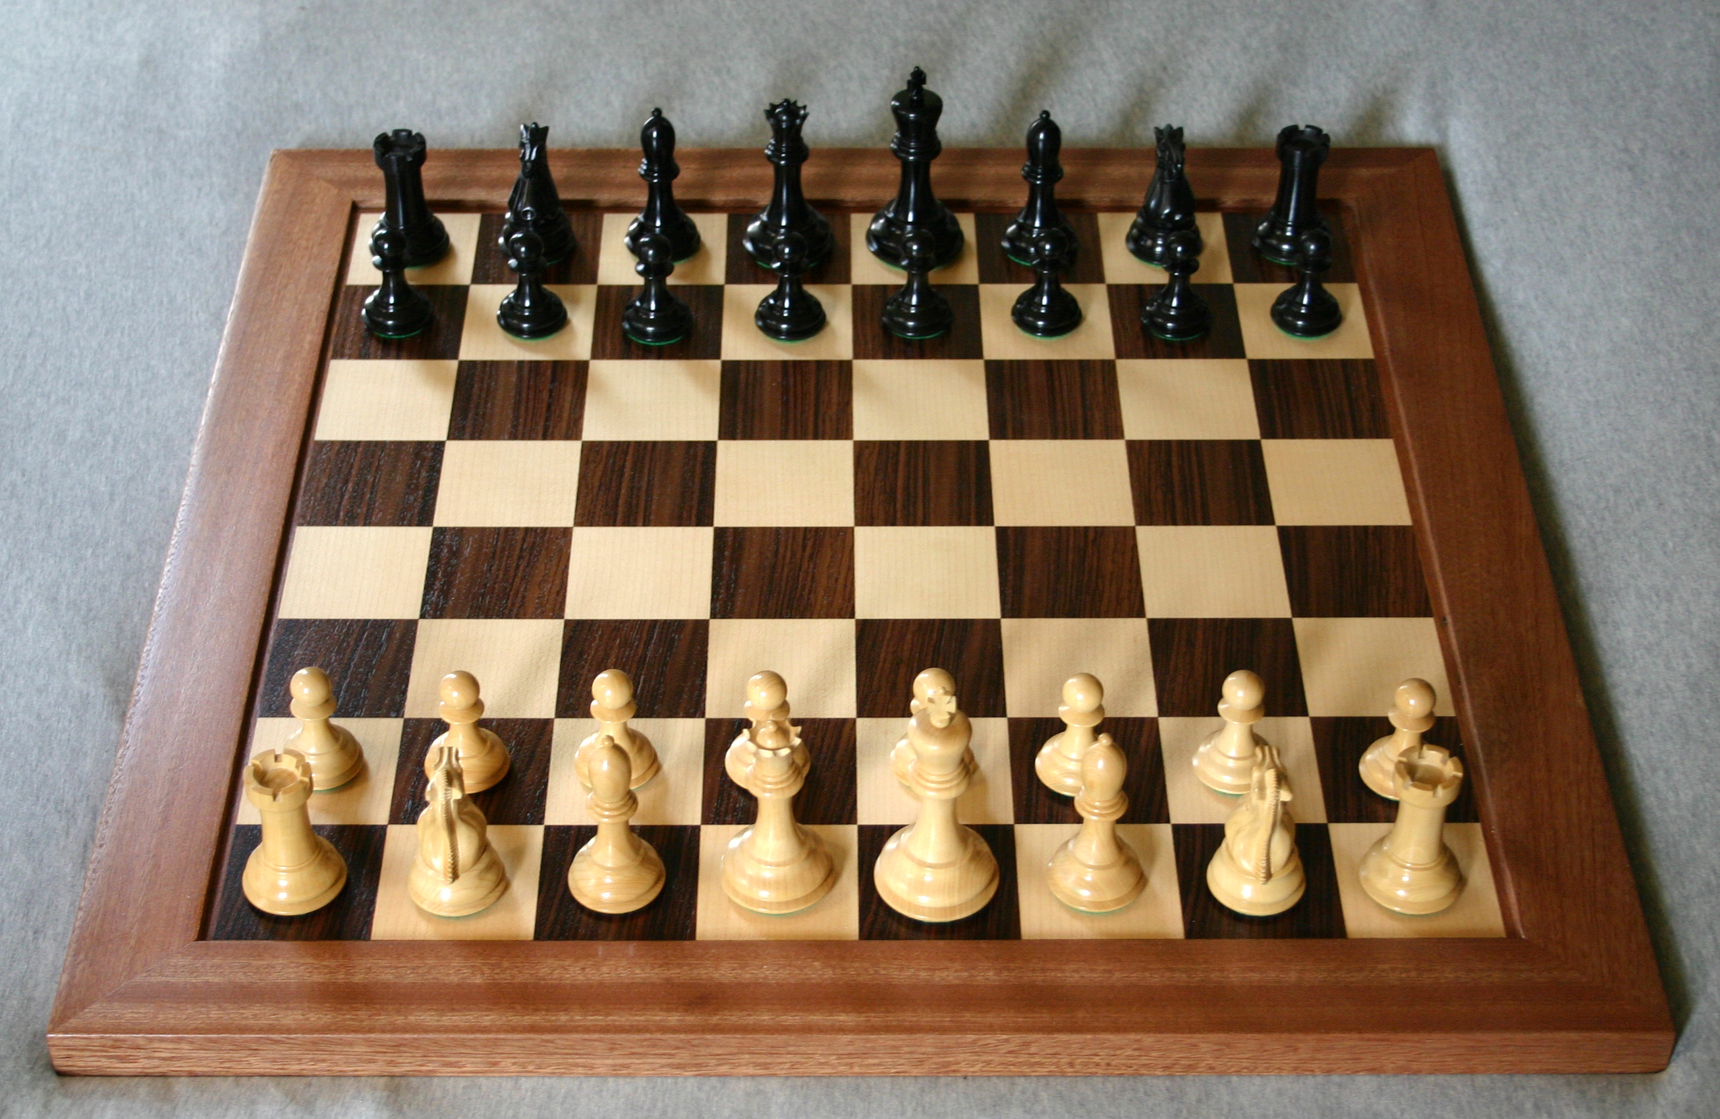
Creating a multidimensional numeric array
Create the board for a chess game with the pieces in their starting positions
Lowercase letter: black pieces
Uppercase letter: white piece
Output
r n b q k b n r
p p p p p p p p
P P P P P P P P
R N B Q K B N R

Slide 49
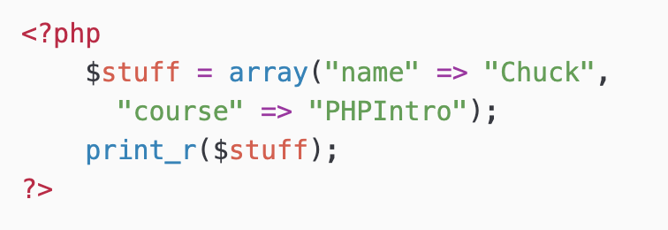
Dumping an Array
The function print_r() dumps out PHP data - it is used mostly for debugging
Output
Array(
[name] => Chuck
[course] => PHPIntro
)

Slide 50
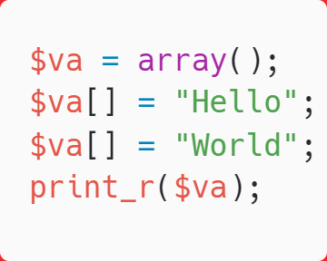
Building up an Array
You can allocate a new item in the array and add a value at the same time using empty square braces [] on the right hand side of an assignment statement
Output
Array(
[0] => Hello
[1] => World
)

Slide 51
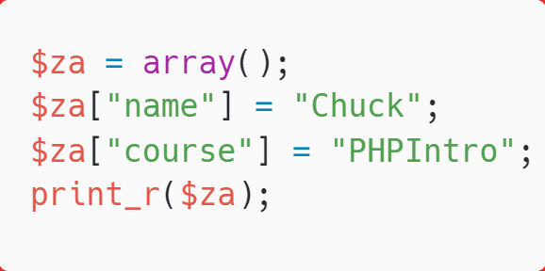
Building up an Array
You can also add new items in an array using a key as well
Output
Array(
[name] => Chuck
[course] => PHPIntro
)

Slide 52
Array Functions
Full list at: https://www.php.net/manual/en/ref.array.php
count($ar) - How many elements in an array
is_array($ar) - Returns TRUE if a variable is an array
isset($ar['key']) - Returns TRUE if key is set in the array
sort($ar) - Sorts the array values (loses key)
ksort($ar) - Sorts the array by key
asort($ar) - Sorts array by value, keeping key association
shuffle($ar) - Shuffles the array into random order

Slide 53
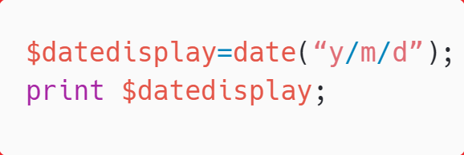
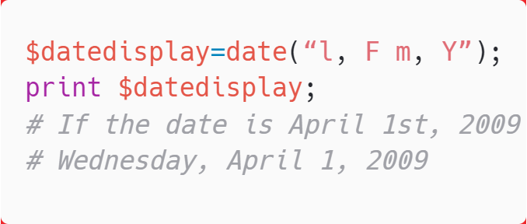
Date Display
More info about this function: https://www.php.net/manual/en/datetime.format.php
Month, Day & Date format symbols
M | Jan
F | January
m | 01
n | 1
Day of Month | d | 01
Day of Month | J | 1
Day of Week | l | Monday
Day of Week | D | Mon
Output
Output
14/1/30
Wednesday, April 1, 2009

Slide 54
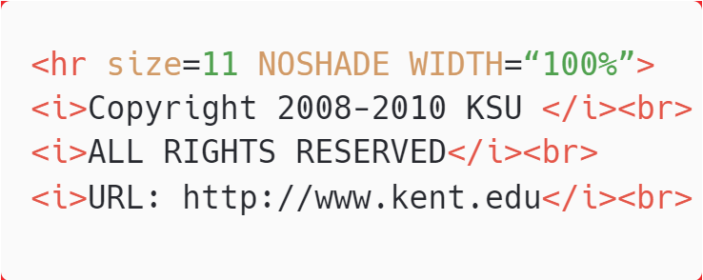
Include Files
include “opendb.php”;
include “closedb.php”;
This inserts files; the code in files will be inserted into current code. This will provide useful and protective means once you connect to a database, as well as for other repeated functions.
The file footer.php might look like:
include (“footer.php”);

Slide 55
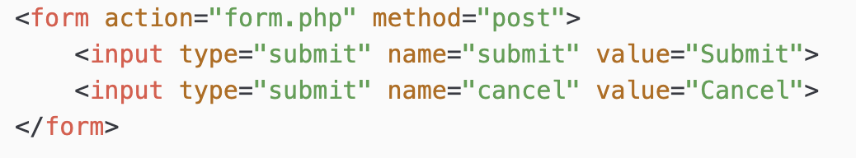
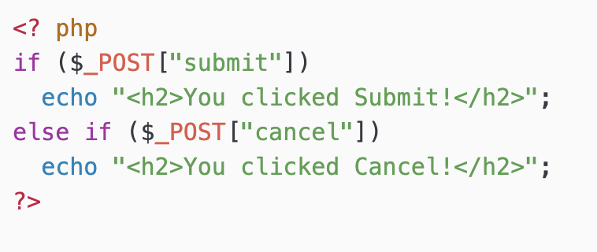
PHP - Forms
Access to the HTTP POST and GET data is simple in PHP
The global variables $_POST[] and $_GET[] contain the request data
On the form page
form.php page
http://www.cs.kent.edu/~nruan/form.php

Slide 56
HTML Forms

Slide 57
Web Data
Most interesting web pages revolve around data
examples: Google, IMDB, Digg, Facebook, YouTube, Rotten Tomatoes
can take many formats: text, HTML, XML, multimedia
Many of them allow us to access their data
Some even allow us to submit our own new data
Most server-side web programs accept parameters that guide their execution

Slide 58
Reading/writing an entire file
URL?name=value&name=value...
query string: a set of parameters passed from a browser to a web server
often passed by placing name/value pairs at the end of a URL
PHP code on the server can examine and utilize the value of parameters
http://example.com/student_login.php?username=xenia&sid=1234567
Notes:
above, parameter username has value xenia, and sid has value 1234567

Slide 59
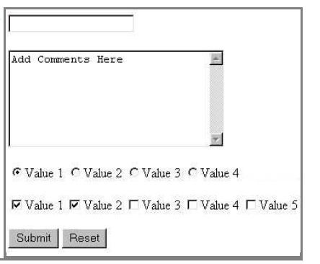
HTML forms
form: a group of UI controls that accepts information from the user and sends the information to a web server
the information is sent to the server as a query string
Notes:
JavaScript can be used to create
interactive controls (seen later)

Slide 60
How Forms Work
Web forms have two components:
The form on the page that collects input
An application on the server that processes the collected information

Slide 61
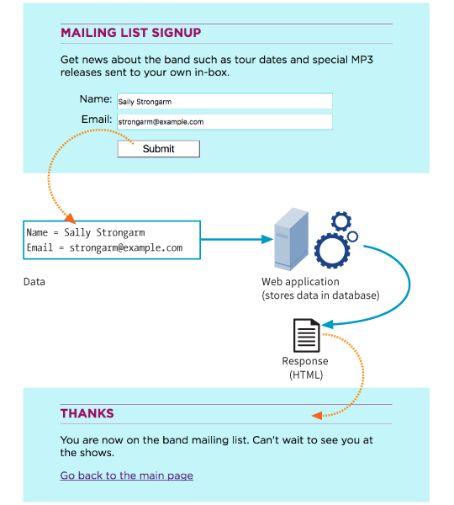
Web Form Transaction
1. Browser renders the form inputs as indicated in the markup.
2. User enters information in the form and hits Submit.
3. The browser encodes the information entered and sends it to the server.
4. The application processes the information.
5. The application returns a response (for example, a thank you message or reloading the page).

Slide 62
Web Processing Applications
Web forms may be processed by any of the following technologies:
PHP (.php)
Microsoft ASP (.asp)
Microsoft ASP.net (.aspx)
Ruby on Rails
JavaServer Pages (.jsp)
Python

Slide 63
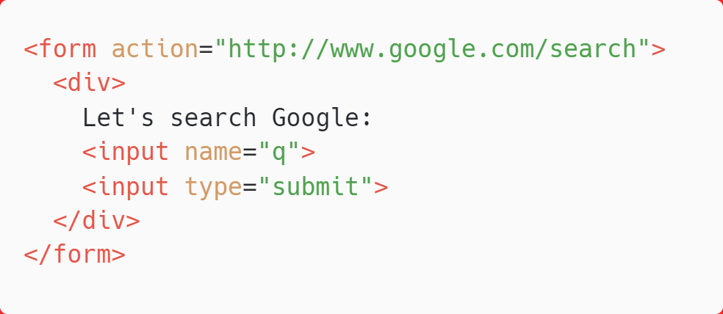
Form example
Wrap the form's controls in a block element such as div

Slide 64
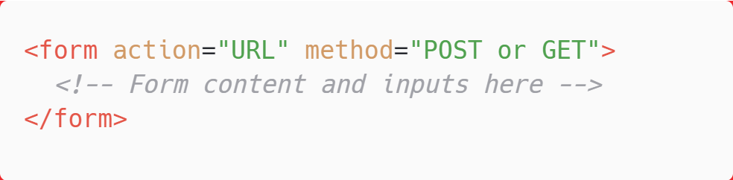
The form Element
The form element is a container for all the content in the form and its input controls.
The action and method attributes are necessary for interacting with the processing program.

Slide 65
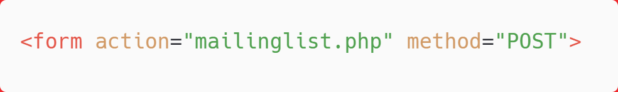
The action Attribute
The action attribute provides the location of the script or application that will process the collected form data.

Slide 66
The method Attribute
<form action="mailinglist.php" method="POST">
The method attribute specifies how the encoded information should be sent to the server (GET or POST):
GET: The encoded data is tacked onto the URL sent to the server:
POST: Data is sent in a separate transaction and can be encrypted with HTTPS.
NOTE: POST is the most common method.

Slide 67
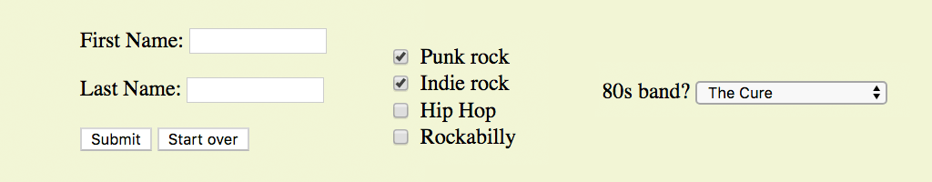
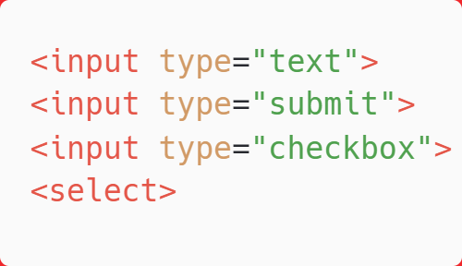
Form Control Elements
Form control elements (also called widgets) collect data from the user. A few examples:

Slide 68
Form Control Elements (cont’d)
Form controls collect data in variable/value pairs.
Examples:
variable = "email"
value = jen@example.com
variable = "color"
value = green

Slide 69
Variables (the name Attribute)
A variable is a bit of information collected by a form control (example: the user’s last name).
The required name attribute in the control element provides the name of the variable for that control:
<input name="lastname">
NOTE: The variable name is also programmed into the web processing script or app, so the name in the markup must match the name in the processor.

Slide 70
Values
The data entered or selected by the user in the form control is the value that gets sent to the server. It is paired with the variable for that control.
You can provide a default value with the value attribute:
Name: <input name="lastname" value="Unknown">
In this example, if the text input is left blank, the value “Unknown” would be sent to the server for the variable “lastname”.

Slide 71
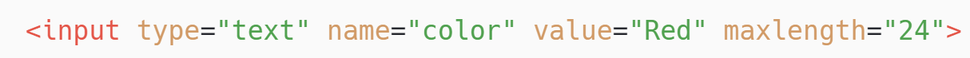
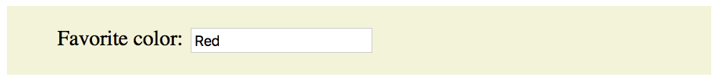
FORM CONTROL ELEMENTS
Text Entry Input
<input type="text">
type: Type of input control, in this case a single-line text field
name: Required variable name
value: Default text that appears in the field and is sent to server if the field is left blank
maxlength, minlength: Sets a character limit for the field
size: The length of the field in number of characters (CSS is more common for sizing)

Slide 72
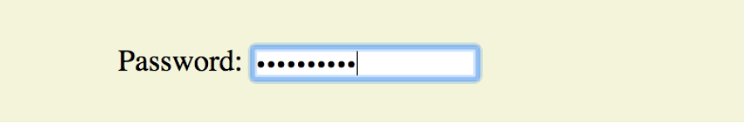
FORM CONTROL ELEMENTS
Password Field
Like a text entry field, except the characters are obscured from view
The data entered is not encrypted on the way to the server (unless it uses HTTPS, a secure web protocol).
<input type="password">

Slide 73
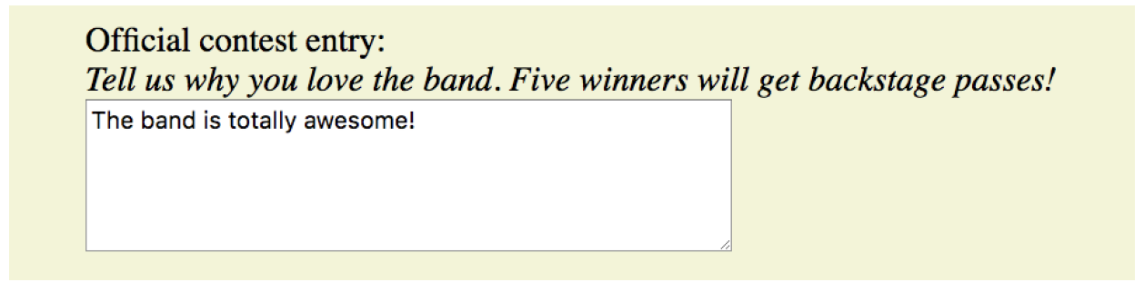
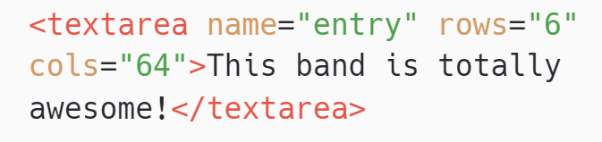
FORM CONTROL ELEMENTS
Multi-line Text Entry
<textarea> </textarea>
The content of the textarea element is the default value.
rows: The number of rows tall the field is initially drawn (users can write more)
cols: Width of initial text field, in number of characters
maxlength, minlength: Limits the number of characters that can be entered

Slide 74
FORM CONTROL ELEMENTS
Specialized Text Entry Fields
<input type="search">
<input type="email">
<input type="tel">
<input type="url">
These input types are more semantically rich than a default text field.
Browsers may provide keyboards tailored to the input type.
Browsers may validate entries on the fly without using the server application.

Slide 75
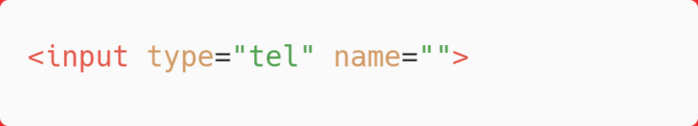
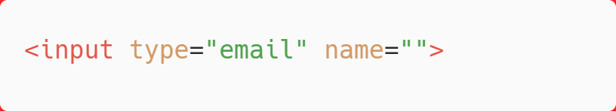
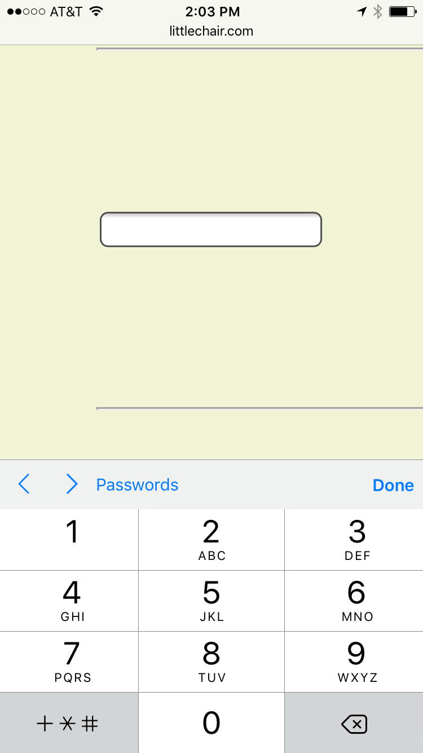
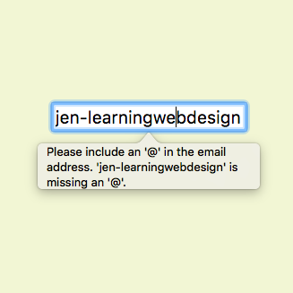
Specialized Text Entries (cont’d)
Numerical keyboard provided on iOS
Opera looks for email address structure

Slide 76

FORM CONTROL ELEMENTS
Submit and Reset Buttons
<input type="submit">
Submits the collected form data to the server. Does not require a variable name (name attribute):
<input type="reset" value="Start over">
Resets the form to its defaults
Less common with the rise of JavaScript for form handling
Change the button text with the value attribute.

Slide 77
FORM CONTROL ELEMENTS
Custom Buttons
<button> </button>
The button element is used for creating custom buttons with JavaScript.
<input type="button">
Creates a custom button that has no predefined function and can be customized with JavaScript
<input type="image" alt="">
Allows an image to be used as a button to replace the Submit button. It requires a descriptive alt attribute value.

Slide 78

FORM CONTROL ELEMENTS
Radio Buttons
<input type="radio">
Only one radio button may be selected at a time.
NOTE: You can’t belong to more than one age group, so radio buttons are the right choice for this list.

Slide 79
Radio Buttons (cont’d.)
<input type="radio" value="">
Applying the same variable name to input elements binds them together as a mutually exclusive set of options.
The value for each button must be provided with the value attribute.
The checked attribute causes an option to be selected when the page loads. Only one input may be checked.

Slide 80

FORM CONTROL ELEMENTS
Checkbox Buttons
<input type="checkbox">
Multiple checkbox buttons may be selected.
NOTE: You can like more than one type of music, so checkbox buttons are the right choice for this list.

Slide 81
Checkbox Buttons (cont’d)
<input type="checkbox" value="">
Applying the same variable name to input elements binds them together as a group.
The value for each button must be provided with the value attribute.
The checked attribute causes an option to be selected when the page loads. Multiple buttons in a group may be checked.

Slide 82
FORM CONTROL ELEMENTS
Drop-down Menus
<select> </select>
<option> </option>
<optgroup> </optgroup>
The select element creates a drop-down menu when there is no size attribute (or if size="1").
The select element contains some number of option elements.
The content of the option element is the value sent to the server (or one can be provided with the value attribute).

Slide 83


Drop-down Menus (cont’d.)
The select menu drops down to reveal options when the user clicks on it.

Slide 84


FORM CONTROL ELEMENTS
Scrolling Menus
The same markup as drop-down menus, but the size attribute specifies how many lines to display.
The multiple attribute allows more than one option to be selected.

Slide 85


Scrolling Menus (cont’d)
Use the optgroup element to create a conceptual group of options.
The label attribute provides the the heading for the group:

Slide 86


FORM CONTROL ELEMENTS
File Upload Control
<input type="file">
The file input type allows a user to select a document from their hard drive to be submitted with the form data.
The method must be set to POST, and the encoding type must be included.

Slide 87

FORM CONTROL ELEMENTS
Hidden Control
<input type="hidden">
Sometimes it is necessary to feed values to the processing script/app that don’t come from the user.
Hidden controls don’t display in the browser.

Slide 88

FORM CONTROL ELEMENTS
Date and Time Controls
<input type="date">
<input type="time">
<input type="datetime-local">
<input type="month">
<input type="week">
A starting value may be provided in standard date-time format.

Slide 89

Date and Time Controls (cont’d)
Browsers may display date and time selection widgets (not universally supported).
On non-supporting browsers, date and time inputs display as usable text-entry fields.

Slide 90

FORM CONTROL ELEMENTS
Numerical Controls
Number and range controls collect numerical data. Browsers may render counter or slider widgets.
Both types accept min and max attributes for setting limits on the allowed values.
<input type="number">
<input type="range">

Slide 91

FORM CONTROL ELEMENTS
Color Selector
<input type="color">
The color input type is intended to provide a pop-up color picker.
It is not well supported. Non-supporting browsers display a text-entry field.

Slide 92
Form Accessibility
Users may not be able to see the form. They may be listening to it with a screen reader.
Whereas sighted users can see at a glance how elements are organized, form accessibility features create semantic connections between form components.

Slide 93

FORM ACCESSIBILITY
Labels
<label> </label>
The label element associates a descriptive label with a form field.
Implicit association
The label text and form control are both contained within the label element:
Explicit association
Matches the label with the control's ID reference using the for attribute:

Slide 94
FORM ACCESSIBILITY
Fieldsets and Legends
<fieldset> </fieldset>
<legend> </legend>
fieldset
Indicates a logical grouping of controls (examples: credit card name, number, date, etc.). By default, rendered with a box around the set of controls.
legend
Provides a caption for the enclosed fields. By default, it’s displayed along the top edge of the fieldset.

Slide 95


Fieldsets and Legends (cont’d)

Slide 96
Form Design Tips
Avoid unnecessary questions.
Consider the impact of label placement. Labels above fields tend to lead to faster completion.
Choose input types carefully.
Group related inputs.
Primary actions (e.g., “Buy”) should be visually dominant to secondary actions (e.g., “Back”).

Slide 97
Submitting data

Slide 98


Data handling
echo <<<_END
Some HTML
_END;
Can use whenever you want to output multiline of HTML

Slide 99
The $_POST Array
A browser sends user input through either GET or POST request
The POST request is usually preferred
The web server bundles up all user input and puts in array $_POST
To access this array, use the element key (ex: “isbn”)
$_POST[’isbn’] or $_POST[“isbn”]
All values in $_POST will be retrieved at the beginning of the program and ignored after that

Slide 100
Sanitizing Input
Handling user data is a security minefield – essential to learn to treat all such data with the utmost caution
Sanitize user input to prevent potential hacking attempts such as
Hacker can just use View Source jeopardize with your form to receive malicious input to your website
JavaScript or MySQL script injection
Instead of just read user input with this code
$variable = $_POST['user_input’];
It is better to use PHP Filter to sanitize input

Slide 101
PHP Filters
Validate and sanitize external input
PHP filter extension has many functions needed for checking user input, easy data validation
External input/data are
User input from a HTML form
Cookies
Web services data
Server variables
Database query results
You should always validate external data!

Slide 102

PHP filter_var() Function
filter_var() filters a single variable with a specified filter
Example: remove all HTML tags from a string
Output
Hello World!

Slide 103

Sanitize and validate an email address
DEMO
When $email = john.doe@example.com Output:
john.doe@example.com is a valid email address
When $email = john.do**e@example.com
Output:
john.do**e@example.com is not a valid email address
More functions in PHP filter: https://www.w3schools.com/php/php_ref_filter.asp
Notes:
http://172.21.39.39/gift/vsc/?folder=/home/gift/www
Sanitize2.php

Slide 104
Validating User Input with JavaScript
JavaScript validation – more like an assistance to users, not to your websites
It should use for checking that fields do not left empty, or format of email address, or values within expected bounds
See provided code validate.html

Slide 105

Self-processing pages
DEMO
One PHP page can be used to both generate a form and subsequently process it
This example request with the GET method, prints a form that accept a temp (F)
If called with POST, the page calculates and display temp (C)
Notes:
http://172.21.39.39/gift/class9/demo/temp1.php

Slide 106

Self-processing pages
DEMO
Another way to decide whether to display a form or process is to check whether parameters are supplied or not (isset)
This example page use GET to submit values and it uses the presence or absence of parameters to determine what to do
The parameter values are copied to $farenheit,
We can also use is_null to check $farenheit before display the form or process the form data
Notes:
http://172.21.39.39/gift/class9/demo/temp2.php

Slide 107


Sticky forms
Many website use this technique
The results of a query are accompanied by a search form (whose default values are those of the previous query)
Example: google search

Slide 108

Sticky forms - implementation
DEMO

Slide 109
End of the topic
End of class 7
Next week: June, 13
PHP Fundamental 2

Slide 110

To do from now
Check Github classroom for this week’s assignment explanation
Demo of how to submit your files
*Different from previous weeks from now on

